Slide 1
Clinic Name/Name of presentation
Early Psychosis Intervention
Ontario Network
Early Psychosis Intervention Ontario Network
Presenters
DATE
Notes:
Note to presenters:
This presentation is a framework to do with as you see fit. This content of these presentation is seen as a baseline of information that could be helpful when presenting to general audiences about early psychosis and early psychosis intervention.

Slide 2
Outline
What is psychosis?
Early Psychosis Intervention Ontario Network
[ANY ADDITIONAL SLIDES/TOPICS]
Notes:
Note to presenters:
Add any additional slides/discussion topics.

Slide 3
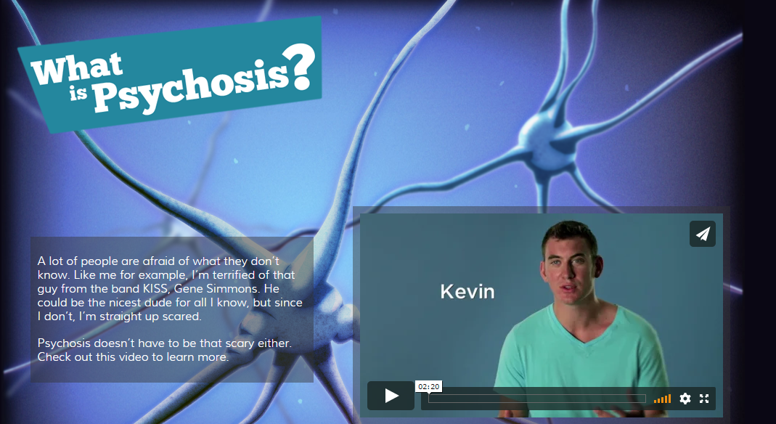
What is psychosis?
Available: www.becauseyourmindmatters.ca
(Because Your Mind Matters, n.d.)
Notes:
Note to presenters:
Click www.becauseyourmindmatters.ca (or click link on slide) to link to video (approx. two minutes long).

Slide 4
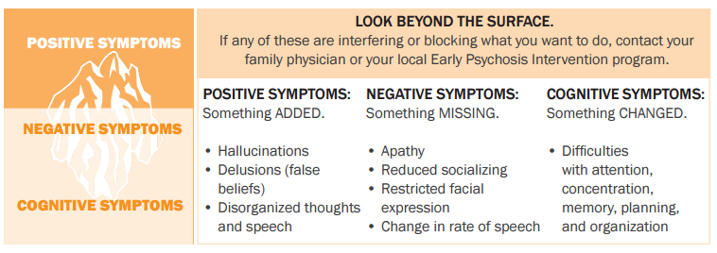
What is psychosis?
A medical condition
A symptom, not a diagnosis
Adapted from: https://help4psychosis.ca/tools-and-resources/infographics/
(EPION, 2018).
Notes:
Notes to presenter:
Used slide to explain how these symptoms are experienced
Some points to consider discussing:
Highlight the differences between positive and negative symptoms as people often associate psychosis solely with positive symptoms.
Positive: What is easily seen (e.g., AH, Delusions, disorganized behaviour)
Negative: Decrease in interest, motivation, enjoyment, paucity of thought, can be easily chalked up to adolescence
Has a big impact on functional recovery
Cognitive: Working memory, verbal fluency, processing speed
Psychosis is the symptom, not a diagnosis (e.g., cough [symptom], pneumonia [diagnosis]).
Psychosis is the umbrella term: for example, schizophrenia is one (of many) possible diagnoses.
Other possible diagnoses include:
organic psychosis
drug-induced psychosis
brief psychosis
delusional disorder
major depression with psychosis
bipolar disorder
schizophreniform disorder
schizophrenia
schizoaffective disorder.
It is often difficult to make a diagnosis during a first episode.
A person with psychosis will have changes in perception:
A person with psychosis may have hallucinations. They may hear voices or sounds that no one else can hear, see things that are not actually there, or smell things that others can’t smell. For the person with psychosis, these experiences feel very real and can be very distressing.
They may experience changes in what they think:
Psychosis can cause our thoughts to spiral out of control, as if you can’t stop them.
It can also make your thoughts come too slow. Some find it harder to pay attention in school or at work, and many say they can’t remember, plan things, complete tasks or follow conversations the way the used to when they were well.
It’s often hard for people with psychosis to stop the frightening thoughts they’re having, and they spend all day detached from others thinking about it, making it difficult to carry on with regular daily activities.
A person may begin to experience delusions. This is a strongly held thought or belief for which there is little proof and that seems illogical to others. Regardless of what you may say or do, the person will believe it. There are different types of delusions, but the most common are:
Paranoid delusions: not trusting others or thinking that they’re out to get you. People with paranoid delusions may think that they’re being watched, or plotted against.
Referential delusions: thinking that a TV show host is talking specifically to them or taking special personal meaning from the mass media (e.g., a famous song was written to send you a message). Someone with referential delusions might also feel personally responsible for important world events, like perhaps a natural disaster was caused by their thoughts. It’s important to recognize that these beliefs are very real to the person experiencing them, and they can be frightening. It becomes very isolating and frustrating for the person with no one to talk to or who believes them.

Slide 5
What is psychosis?
Adapted from: https://help4psychosis.ca/tools-and-resources/infographics/
(EPION, 2018).
Notes:
Note to presenter:
Use this slide to highlight behaviours (i.e., what psychosis might look like for somebody). Go through the points on the infographic to highlight this.
Consider highlighting how symptoms translate into behaviour (e.g., someone who is attending to AH may seem distracted).
Discuss changes in behaviour:
People with psychosis may behave differently than they usually do. This is often a reaction to symptoms like hallucinations or delusions.
Some common changes in behaviour are things like:
becoming extremely active or agitated
laughing or conducting themselves inappropriately
becoming guarded or untrusting
isolating themselves—withdrawing from extra curricular activities
holding their body in strange postures or making odd gestures
having difficulty organizing themselves to perform regular daily activities like cooking or showering
having low energy or appearing slowed down
showing little or no expression or joy in activities they used to like
avoiding conversation and eye contact
appearing bored, uninterested or cold.
In post secondary school, for example, you may see:
discomfort around people—avoiding class (especially with group work)
difficulty concentrating in class
a drop in marks
difficulty with reading comprehension
falling behind—effects on self esteem
low mood and lack of facial expression
avoids events in dorm and on campus
decreased hygiene
lack of interest in many activities
disorganization in thinking, writing, speech
spending more time in room alone
difficulty with sleep—affects concentration
may initially present with expressed depression or anxiety
increased isolation, difficulty connecting with campus services, especially if not living on campus.
The symptoms described above are the more common symptoms seen in people with psychosis, but it’s not exhaustive. To the same effect, these same symptoms can be caused for other reasons, like thyroid problems, infection, a drug addiction or withdrawal states. Because of that, part of the process of diagnosing someone with psychosis involves checking to see if there may be another medical cause for their symptoms.

Slide 6
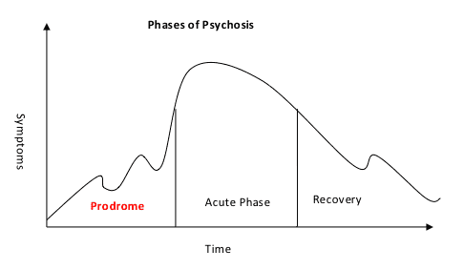
What is psychosis?
Prodrome (‘pre’-psychosis):
Before a psychotic episode, we often see gradual changes in the person's thoughts, perceptions, behaviours, and functioning.
This stage can’t be diagnosed.
Acute psychosis:
Psychotic symptoms emerge (e.g., hallucinations, delusions and odd or disorganized speech or behaviours)
Treatment for psychosis needs to be started as soon as possible.
Recovery:
Most people begin to recover once treatment begins (e.g., symptoms get less intense or disappear, and people can better cope day-to-day, return to roles).
Adapted from: https://www.earlypsychosis.ca/phases-of-psychosis/
(BC Early Psychosis Intervention Program, 2021)
Notes:
Note to presenter:
Use this slide to show sequence of symptom onset and introduce importance of early intervention in recovery.
Some points to consider:
Prodrome: Something is not “quite right,” but otherwise unexplained drop in functioning. Can’t be diagnosed (i.e., often seen retroactively).
Symptoms include:
decreased concentration and attention
unexplained struggles with work & school
decreased motivation
depression
changes in sleep
social withdrawal
anxiety
suspiciousness
Irritability.
Recovery: Some of the symptoms that emerged in the acute phase may linger in the recovery phase, but with appropriate treatments, the vast majority of people successfully recover from their first episode of psychosis.

Slide 7
What is psychosis?
Affects about 3/100 people (as common as type 2 diabetes)
Occurs equally throughout the world regardless of race, culture, intelligence, background, religion, gender, income.
First onset generally occurs in young adults, between 16–30 years old:
First episode in females generally a little later than males (“hot spot” ages ~21–25 vs. ~17–21 males)
There is no one “cause” of psychosis but some risk factors are:
environmental influences
trauma/stress
genetics
physical illness or injury
substance use.
Adapted from: www.psychosis101.ca; www.nami.org/earlypsychosis & Janoutova et al. (2016)
Notes:
Note to presenter:
Use this slide to talk about incidence of psychosis and risk factors.
Notes on risk factors:
Environmental influences: Prenatal complications, immigration, viral infections and urban living
Trauma/Stress: Historical trauma (e.g., assault, racism, abuse…)
Physical illness or injury: Traumatic brain injuries, brain tumors, strokes, HIV and some brain diseases such as Parkinson’s, Alzheimer’s and dementia
Genetics: Higher risk for individuals with family history of mental illness, 13% likelihood for individual with a parent who has SCZ
Substance use: Marijuana in particular has been associated with increased risk of schizophrenia, particularly for youth who’ve use at young age.

Slide 8
What is psychosis?
(Because Your Mind Matters, n.d.)
From: www.becauseyourmindmatters.ca
Notes:
8
Note to presenter:
Image links to video (approx. two minutes) on the stress vulnerability model.

Slide 9
Early psychosis intervention
Psychosis is treatable, people can and do recover!
The longer the duration of untreated psychosis, the higher the risk of:
derailing of life goals and functioning (e.g., relationships, school, work)
hospitalization
suicide
substance abuse
disability
involvement with justice system.
The sooner, the better!
Notes:
Note to presenter:
Use this slide to introduce importance of early intervention.
Consider risks of not intervening (e.g., young people may drop out of school, risk of suicide…).
Introduce the concept of duration of untreated psychosis.
Early Psychosis Intervention programs are founded on hope and recovery.
Research suggests that EPI may:
improve outcomes, especially if duration of untreated illness is limited
decrease or eliminate hospital admissions
help youth reclaim their lives
maintain healthy lifestyle with or without chronic illness
support families and caregivers
eliminate need for long-term mental health services/psychiatry
keep youth in their communities
prevent youth from getting involved with justice system
preserve cognitive abilities like attention, concentration.

Slide 10
Early Psychosis Intervention services
Early Psychosis Intervention (EPI) teams are specialized services for young people experiencing early symptoms of psychosis based on provincial standards (MOHLTC, 2011).
They offer:
comprehensive assessment
therapeutic, medical and psychosocial support
intensive follow up and case management
family support
focus on recovery and hope
research, capacity building and education.
It is important to intervene as soon as possible.
Notes:
Note to presenter:
Use this slide to go over EPI services and how they meet the needs addressed above. Early Psychosis Intervention programs are founded on hope and recovery.
Consider:
highlighting ways in which you program addresses this
highlighting your current waitlist (e.g., two weeks).
EPI services:
may improve outcomes, especially if duration of untreated illness is limited, according to research
decrease or eliminate hospital admissions
help youth reclaim their lives
maintain healthy lifestyle with or without chronic illness
support families and caregivers
eliminate need for long-term mental health services/psychiatry
keep youth in their communities.
Pick and choose slides depending on target, and provide more program-specific demographics and access to care (new slide) on how to refer to each of the programs.

Slide 11
Our Early Psychosis Intervention program
[Direction on how to refer to your local program]
Notes:
Note to presenter:
Include information about how to refer to your program (i.e., contact information, waitlist, process).

Slide 12
[Write out key takeaways/local program information]
Notes:
Note to presenter:
Consider using this slide (or add another slide) to summarize your key takeaways from the talk on the right hand side.

Slide 13
Resources
Early Psychosis Prevention Network - https://help4psychosis.ca/
BecauseYourMindMatters.ca
Psychosis101.ca
EPIcanada.ca
EarlyPsychosis.ca
Ministry of Health and Long Term Care (2011). "Early Psychosis Intervention Program Standards."
Add local resources

Slide 14
Additional modules/EPION slide decks
Cannabis
Back to school help
Recovery philosophy
What to do if you’re worried about someone.

